Slide 1
Mode and median

Slide 2
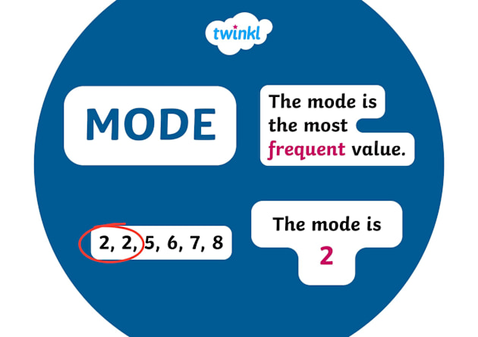
Mode
Mode – is the most frequent value in the given data. There can be none or multiple of those.

Slide 3
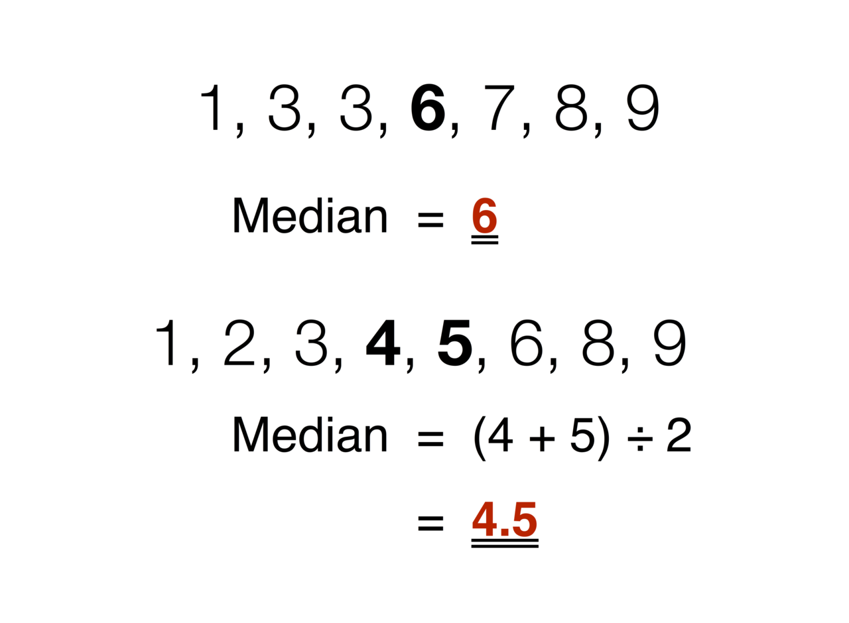
Median
Median – is the central value in the given data.
For odd sets, it’s the central value; for even sets, it’s the two central values added up and divided by 2.

Slide 4
Examples of usage
Median
Mode
01
02
For example, sorted salary data, if everyone recieves 3000$ a month, but one person receives 10000$, the mean will give a misleading average, the median will remain the same
For example, you want to know the most favourite colors amongst people, but you can’t mathematically average them. Modal comes in handy here.

Slide 5
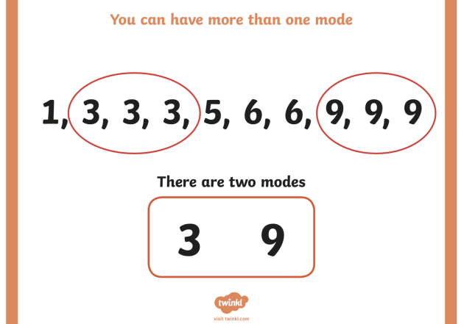
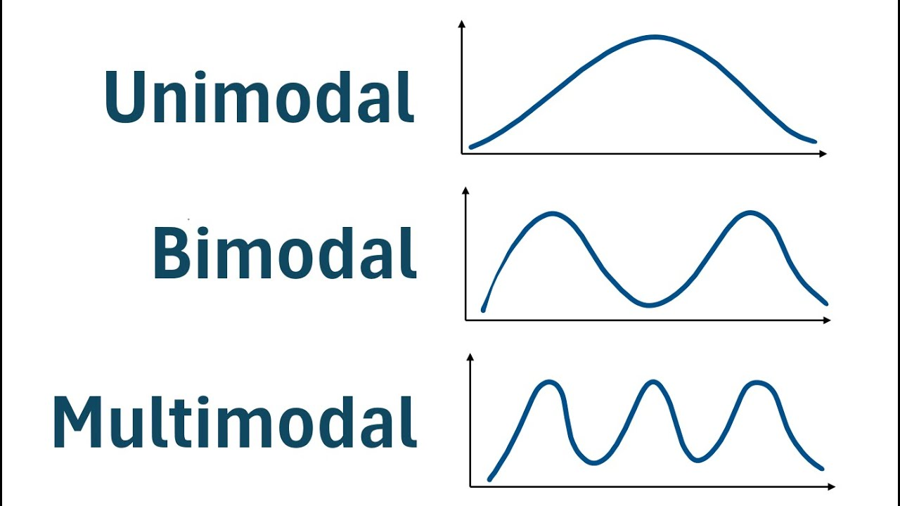
Bimodal/Multimodal distributions
You can have multiple modes(most frequent values). Bimodal – you have two modes, multimodal – more than two.

Slide 6
Exercise
Age | No of People
17 | 3
19 | 1
20 | 2
22 | 2
23 | 1
25 | 3
17 and 25 are most frequent(n = 3), that means they are modes. We have a bimodal distribution

Slide 7

17,17,17,19,20,20,22,22,23,25,25,25
$$\frac{20+22}{2}=21 (median)$$

Slide 8
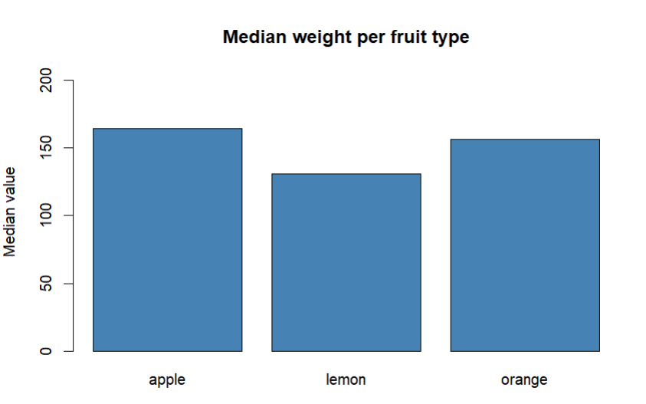
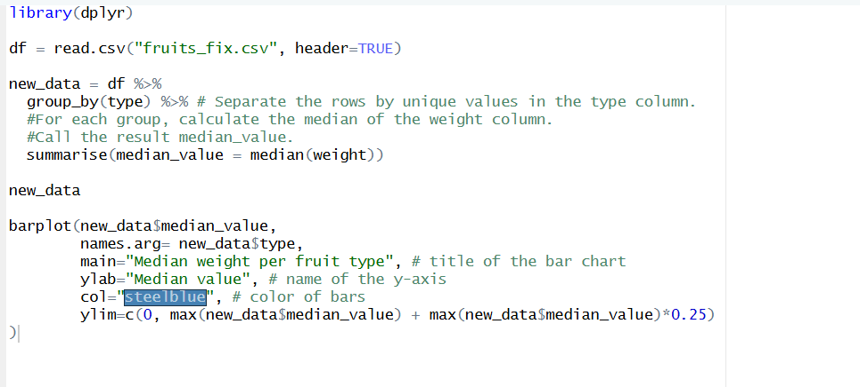
Bar chart of median weight per fruit type

Slide 9
Thanks!

